Slide 1

الاكاديمية العربية للساب
Arabic SAP Academy
Sales And Distribution (SD) S4HANA

Slide 2
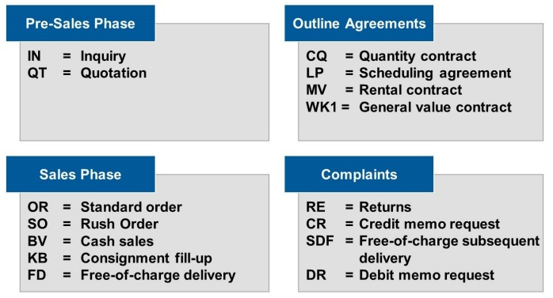
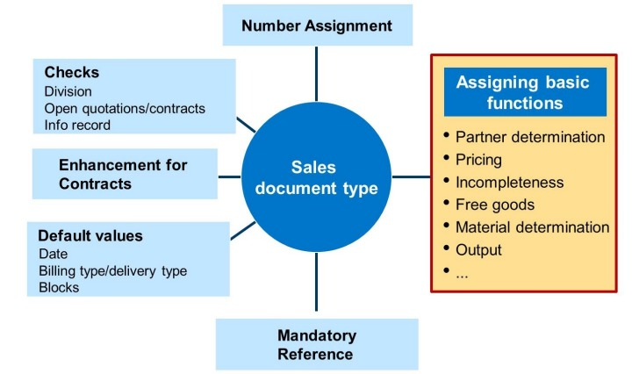
Sales Document Types
Function of sales document type
Examples of Sales Document Types
Order Types Permitted for Sales Area

Slide 3
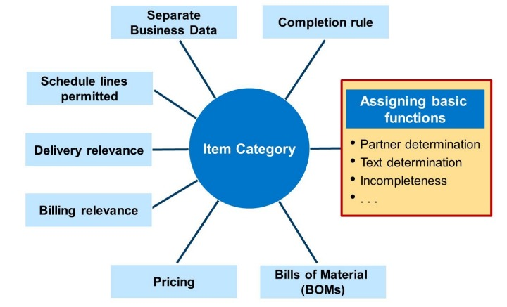
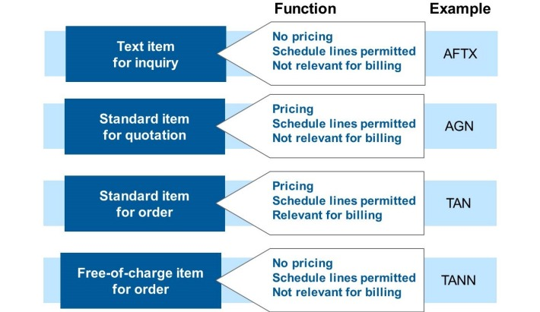
Item Category
Item Category Functions
Controlling the Items in the Sales Document

Slide 4
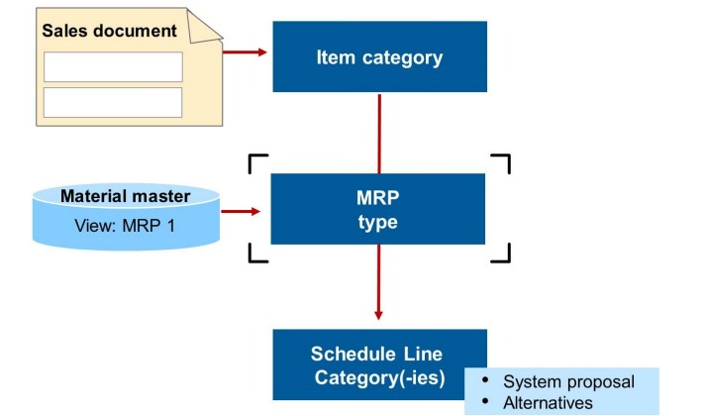
Assignment Item Category to Sales Document Type

Slide 5
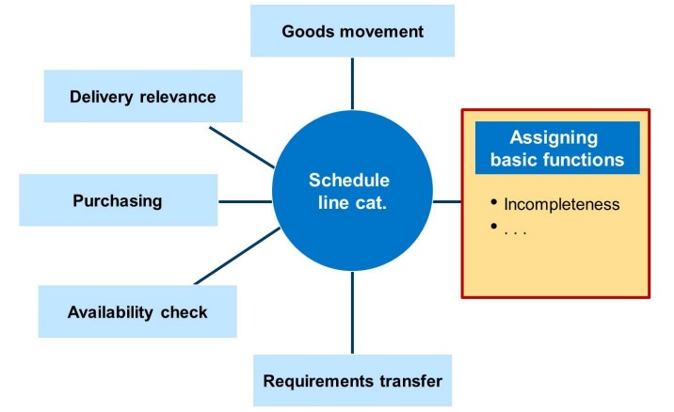
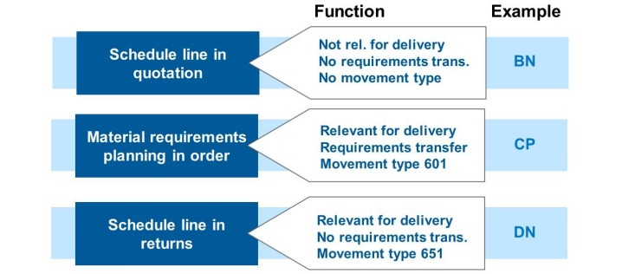
Schedule Line Categories
Function of Schedule Line Category
Controlling Schedule Lines in Sales Documents

Slide 6
Assigning Schedule Line Categories to Item Categories

Slide 7
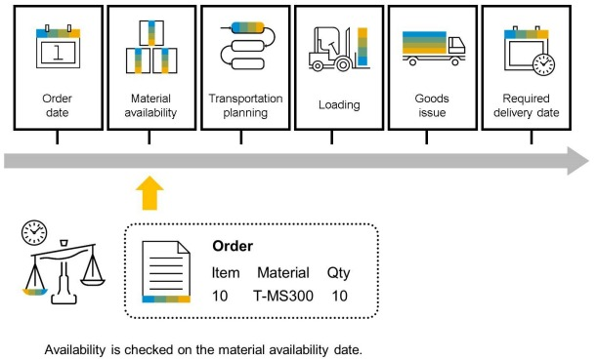
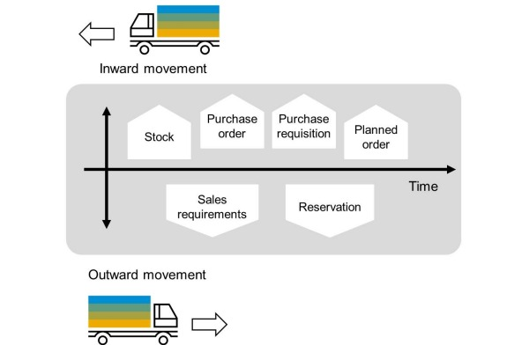
Availability check

Slide 8
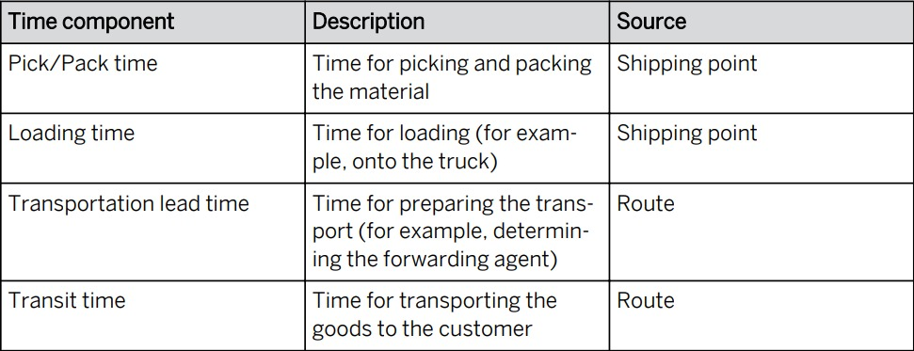
Delivery and Transportation Scheduling
Material availability date
Transportation planning date
Loading date
Goods issue date
Delivery date
Backward Scheduling
Forward Scheduling

Slide 9
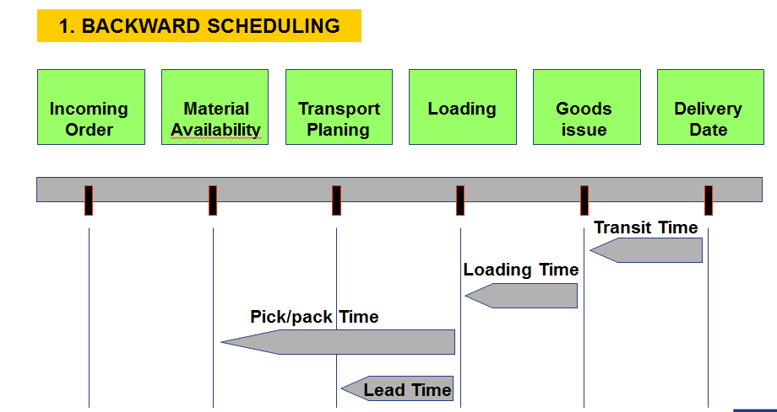
Backward Scheduling

Slide 10
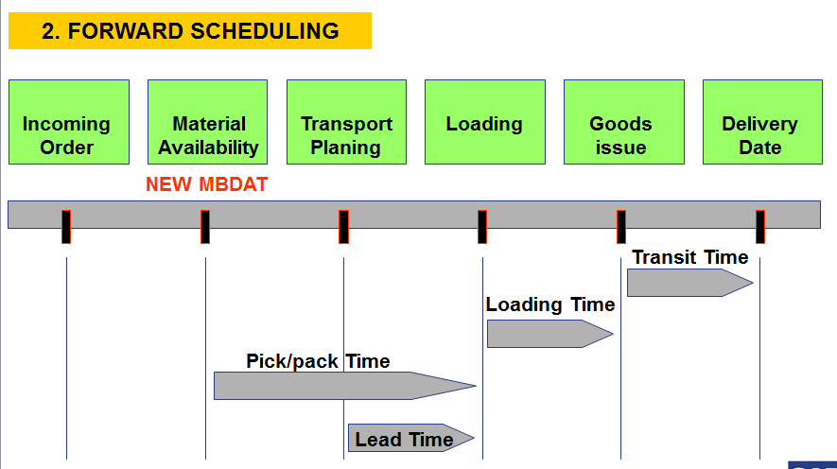
Forward Scheduling

Slide 11
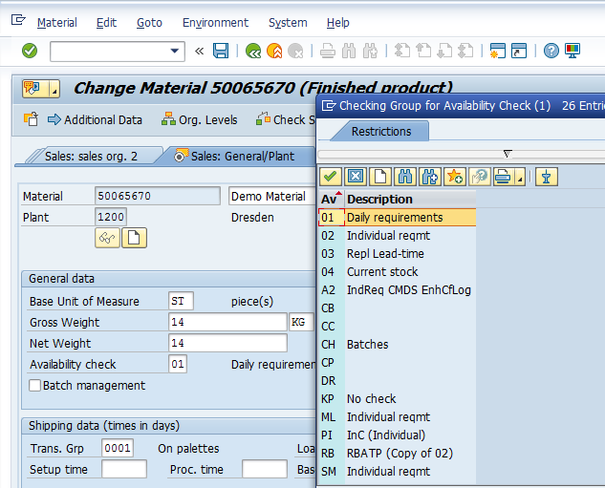
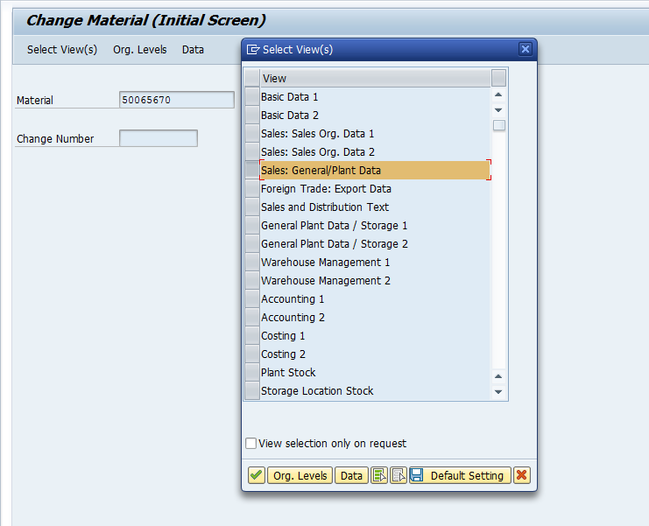
Availability Check(Checking Group)

Slide 12
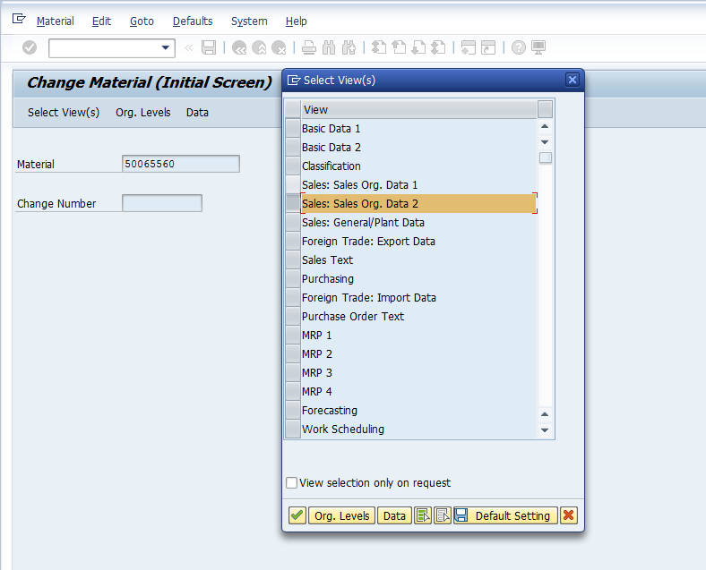
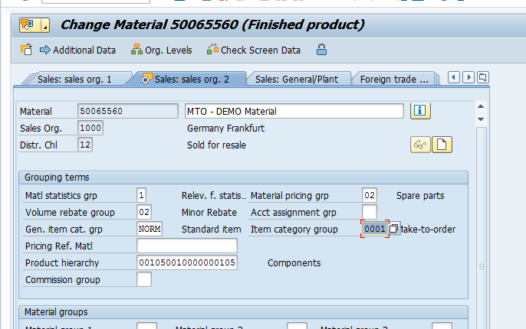
Production Strategies
Make-to-Stock
Make-to-Order

Slide 13
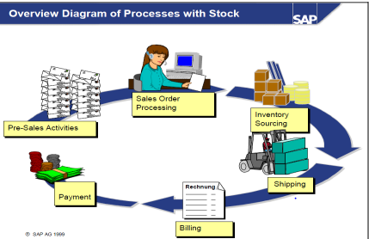
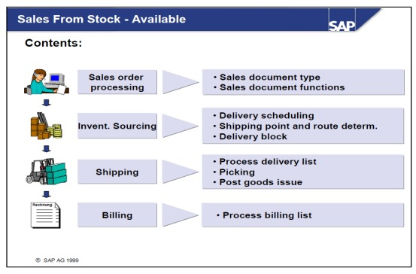
Sales From Stock - Available

Slide 14
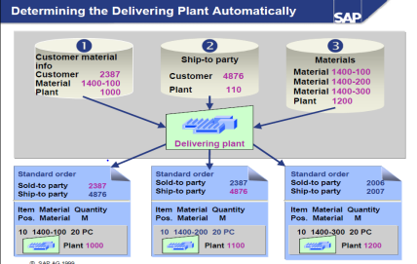
Determining the Delivering Plant Automatically

Slide 15
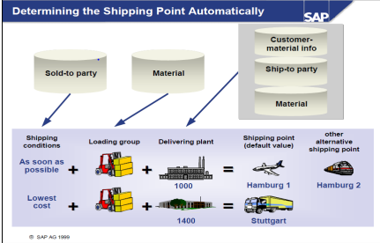
Determining the shipping point Automatically

Slide 16
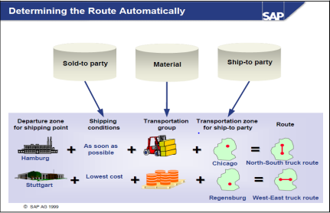
Determining the route Automatically

Slide 17
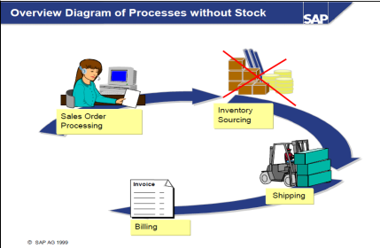
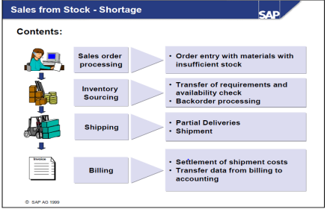
Sales From Stock – Shortage
Process without stock

Slide 18
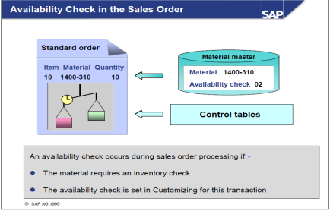
Availability check in the sales order

Slide 19
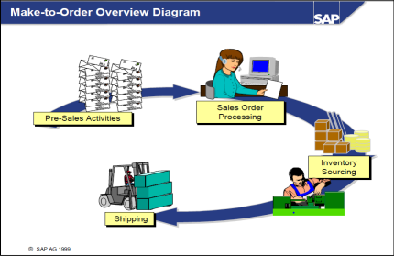
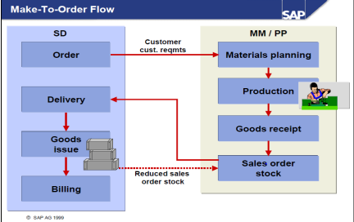
Make-to-Order

Slide 20

Thank you

